Slide 1
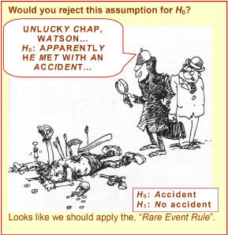
Chapter 9: Hypothesis Tests Based on a Single Sample
http://www.rmower.com/statistics/Stat_HW/0801HW_sol.htm

Slide 2
Assumptions for Inference
We have an SRS from the population of interest.
The variable we measure has a Normal distribution (or approximately normal distribution) with mean μ and standard deviation σ.
We don’t know μ
but we do know σ (Section 9.3)
We do not know σ (Section 9.5)

Slide 3
9.1: The Parts of a Hypothesis Test - Goals
State the steps that are required to perform a hypothesis test.
Be able to state the null and alternative hypothesis.

Slide 4
Hypothesis
In statistics, a hypothesis is a declaration, or claim, in the form of a mathematical statement, about the value of a specific population parameter (or about the values of several population characteristics).
A Hypothesis Test is a formal procedure for comparing observed data with a claim (also called a hypothesis) whose truth we want to assess.

Slide 5
Parts of a Hypothesis Tests
A. The claim assumed to be true.
B. Alternative claim.
C. How to test the claim.
D. What to use to make the decision.

Slide 6
Statistical Hypotheses
A. Null Hypothesis: H₀:
Initially assumed to be true.
B. Alternative Hypothesis: H_{a}
Contradictory to H₀

Slide 7
Parts of a Hypothesis Tests
A. The claim assumed to be true.
B. Alternative claim.
C. How to test the claim.
A test statistic, TS calculated from the sample data measures how far the data diverge from what we would expect if the null hypothesis H₀ were true.
D. What to use to make the decision.

Slide 8
Parts of a Hypothesis Tests
A. The claim assumed to be true.
B. Alternative claim.
C. How to test the claim.
D. What to use to make the decision.
The p-value for a hypothesis test is the smallest significance level for which the null hypothesis, H₀, can be rejected.

Slide 9
9.2: Hypothesis Test Errors and Power - Goals
Describe the two types of possible errors and the relationship between them.
Define the power of a test and what affects it.

Slide 10
Error Probabilities
 |  | Decision
 |  | Reject H₀ | Fail to reject H₀
Truth | H₀ is true
 | H₀ is false (H_{a} is true)
If we reject H₀ when H₀ is true, we have committed a Type I error.
P(Type I error) = α
If we fail to reject H₀ when H₀ is false, we have committed a Type II error.
P(Type II error) = β, Power = 1 - β

Slide 11
Types of Error
http://www.rmower.com/statistics/Stat_HW/0801HW_sol.htm

Slide 12
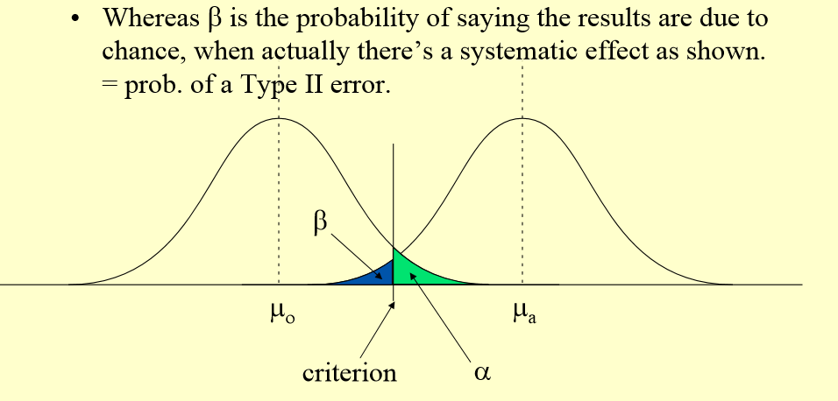
Type I vs. Type II errors (4)

Slide 13
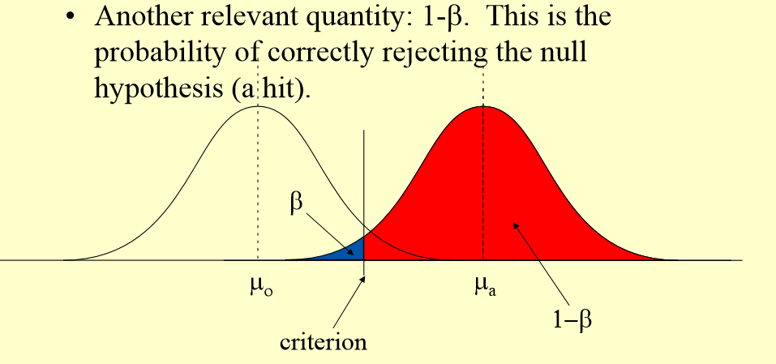
Type I vs. Type II errors (5)

Slide 14
Errors
α measures the strength of the sample evidence against H₀.
The power measures the sensitivity (true negative) of the test.

Slide 15
Increase the power
α
μ_{a}
σ
n

Slide 16
Type I vs. Type II errors (4)
• α • μ_{a} • σ • n

Slide 17
Extra Discussion Question
Why is the US Judicial system a good example for hypothesis tests?
What is H₀?
What is H_{a}?

